Slide 1


Massachusetts General Hospital Performance Analysis
(DEPI – Power BI Track 2025)

Slide 2

Introduction & Project Scope
Project's goal:
To analyze the operational and financial performance of Massachusetts General Hospital using an interactive Power BI dashboard. The analysis focuses on identifying patterns in admissions, encounters, procedures, and revenue to evaluate hospital efficiency and patient care outcomes. The findings highlight areas of excellence and improvement for academic and administrative review.

Slide 3

Introduction & Project Scope
The Dashboard consists of four sections:
Admissions: Analyzing the total volume and categories of patient entries.
Encounters: Tracking the duration, volume (974 unique patients), and financial outcomes (revenue/cost) of patient visits.
Procedures: Evaluating the efficiency (duration), volume (39K), and financial returns (revenue/cost) of medical interventions.
Revenue: Breaking down the total financial intake and correlating it with costs, payer coverage, and patient burden.

Slide 4


Introduction & Project Scope
Audience Personas:
1. Clinical Director: Uses the dashboard to monitor care outcomes and readmission trends. 2. Hospital Administrator: Tracks patient flow, occupancy, and departmental efficiency. 3. Finance Officer: Assesses profitability and cost control. 4. Data Analyst: Leverages data models to predict performance trends.

Slide 5


Methodology & Work Plan
Data Preparation: Import hospital data into Power BI, clean and model relationships between tables (patients, admissions, procedures, and payers).
2. Measure Creation: Develop DAX measures for KPIs such as average Total Encounters, Total Procedures, length of stay, and Patient Count.
3. Dashboard Design: Create interactive pages (Landing, Encounters, Procedures, Revenue, and Demographics).
4. Testing: Validate calculations and KPIs for accuracy.
5. Documentation & Presentation: Compile academic and professional reports for final evaluation.

Slide 6
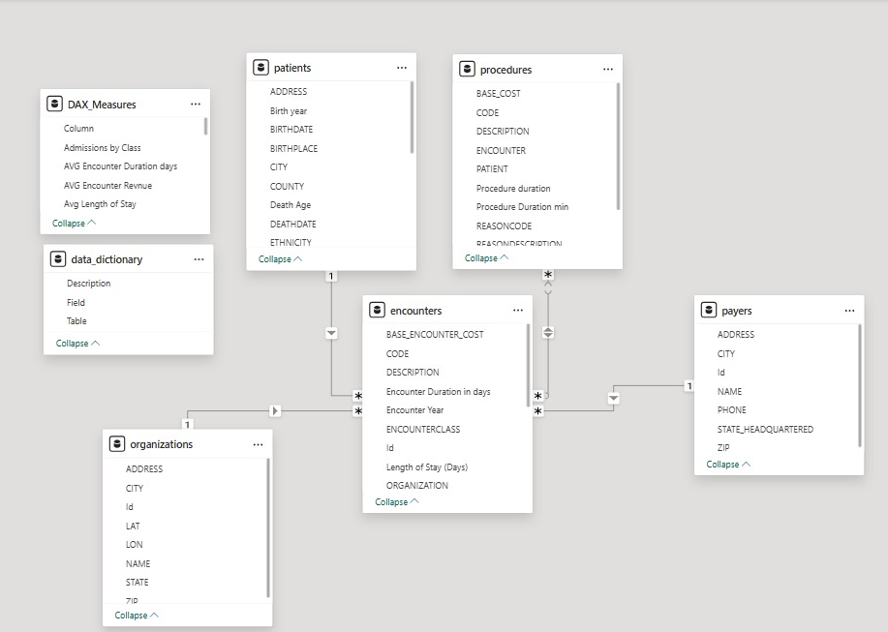
Star Schema
1 Fact Table

Slide 7


Dashboard Design & Visual Identity

Slide 8
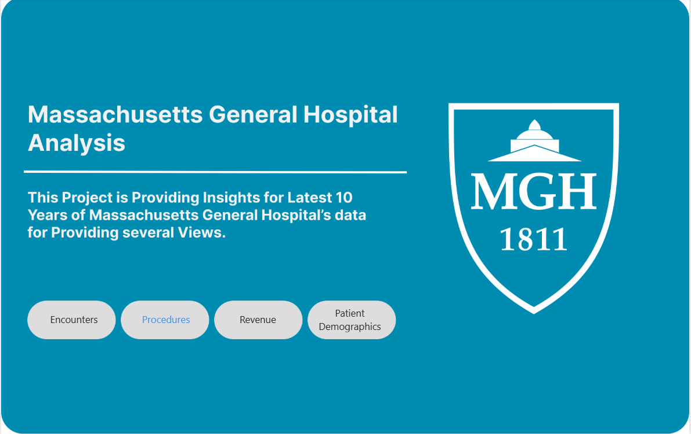
Dashboard Design & Visual Identity
1. Landing Page
Overview of Dashboards (Admissions, Revenue, Costs).

Slide 9
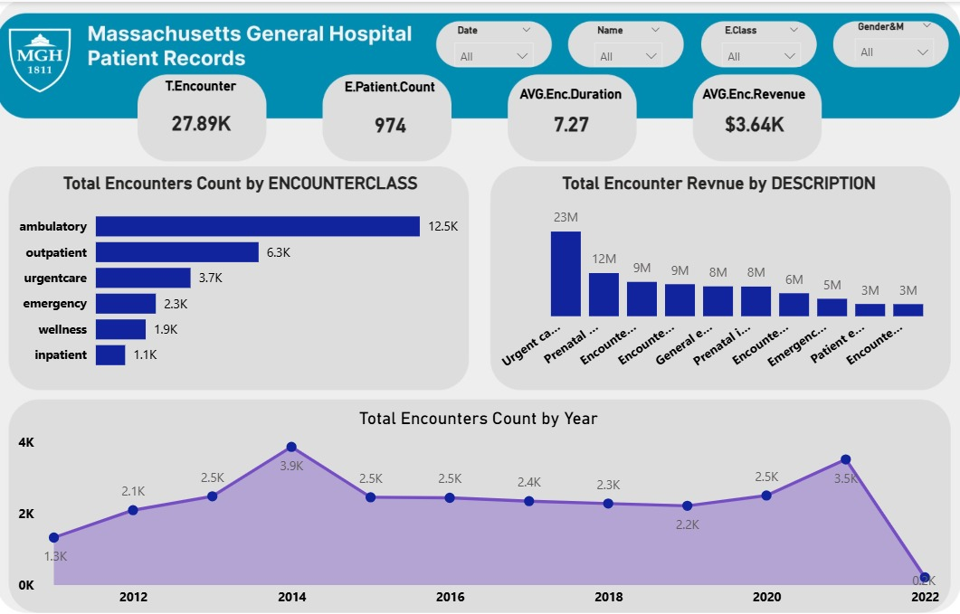
Dashboard Design & Visual Identity
2. Encounters Page
Displays encounter trends and durations.

Slide 10
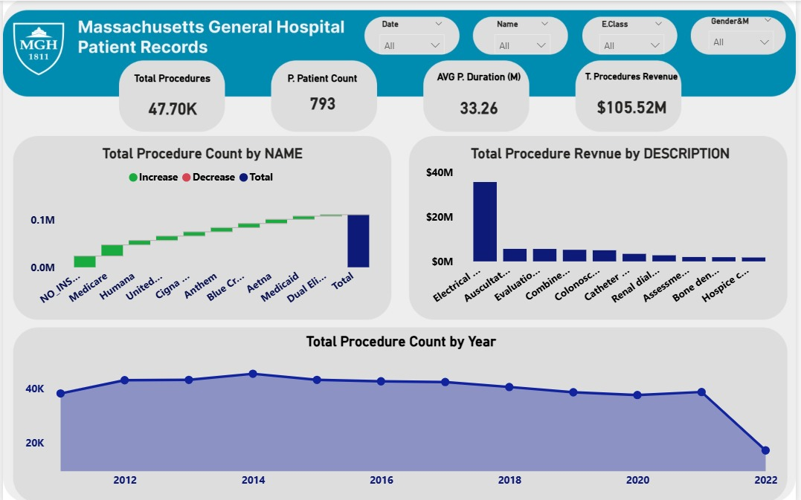
Dashboard Design & Visual Identity
3. Procedures Page
Shows frequency, costs, and outcomes of procedures.

Slide 11
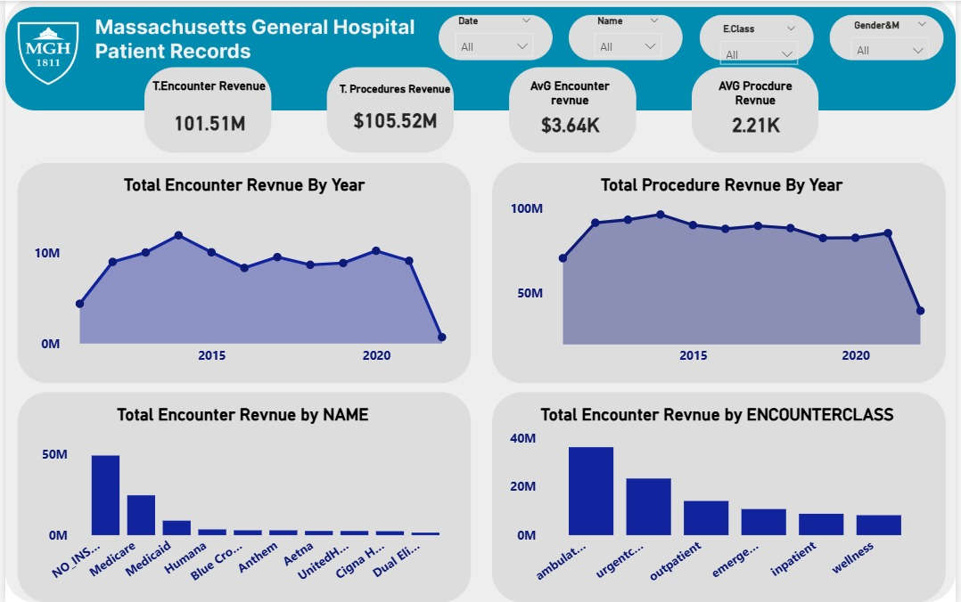
Dashboard Design & Visual Identity
4. Revenue Page
Breaks down revenue by payer and service line.

Slide 12
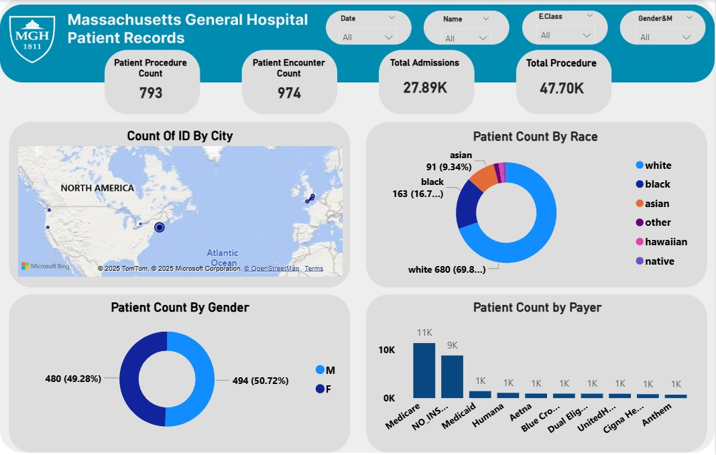
Dashboard Design & Visual Identity
5. Patients Demographics
Displays age, gender, and regional breakdowns.

Slide 13

Key Performance Indicators (KPIs)
Operational Efficiency:
Highlight successful operational metrics:
High Throughput: Total Admissions (28K) and Total Procedures (39K).
Procedure Efficiency: Avg. Procedure Duration (34.32 min).
Admissions Status: On Target ( > $ 25 K)

Slide 14

Financial overview:
Balanced Finances: Total Encounter Revenue equal ($101.51M),and Total Procedure Revenue equals ($105.52M),
Strong Return: Avg. Procedure Revenue ($2.21K).
Key Performance Indicators (KPIs)

Slide 15
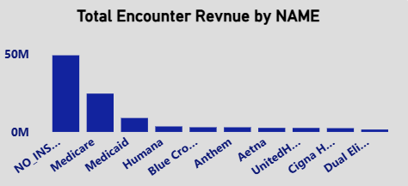
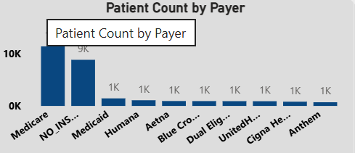
Conclusion & Recommendations
Actionable Recommendations:
Provide concrete steps based on your critical KPIs:
Patient with no insurance has the highest revenue $49 M, with 9k encounters
While Medicare has 9K encounters with half of the revenue $25M
Address Patient Coverage: Develop strategies to increase insurance utilization to mitigate the heavy patient financial burden and improve financial sustainability.
Develop a media campaign to target more patients.
Develop a media campaign to target more patients. Increase the number of patients from different insurance companies to reach the leading company for the hospital (Medicare)

Slide 16
Conclusion & Recommendations
Actionable Recommendations:
Provide concrete steps based on your critical KPIs:
Address Patient Coverage: Develop strategies to increase insurance utilization to mitigate the heavy patient financial burden and improve financial sustainability.
Develop a media campaign to target more patients.
Develop a media campaign to target more patients. Increase the number of patients from different insurance companies to reach the leading company for the hospital (Medicare)

Slide 17
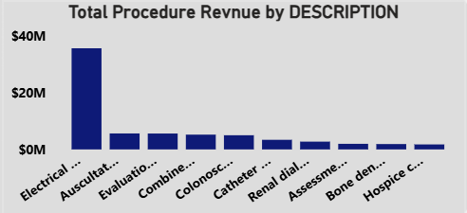
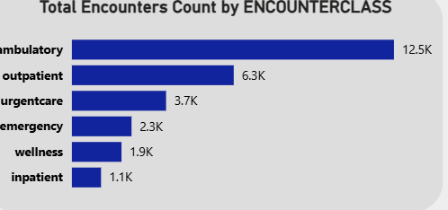
Conclusion & Recommendations
Actionable Recommendations:
Provide concrete steps based on your critical KPIs:
Electro cardioversion is the most profitable procedure.
Hospice care need more development as it is the least profit procedure.
Increase the efficiency of wellness and inpatient encounters as the are the lowest admission categories.

Slide 18

Roles & Responsibilities
Aya Farid – DAX measure creation and KPI calculations.
Sara Mohamed – Data modeling, dashboard integration, report coordination. Noha Yaseen – Visualization design and theme formatting. Alshaymaa Mostafa – Documentation, editing, and presentation design.

Slide 19


